Slide 1
Public Service Loan Forgiveness
Presented by
William Lindsey, FedLoan Servicing
Proprietary Sector Representative

Slide 2

Agenda
Program Overview
Eligibility/Qualification
Implementation at FedLoan Servicing
  Borrower Experience
  School Support

Slide 3
Overview
The Public Service Loan Forgiveness Program (PSLF) was created to encourage individuals to enter and continue to work full-time in public service jobs.
Enacted as part of College Cost Reduction and Access Act (CCRAA) of 2007
Public Law 110-84, 9/27/2007
Final Rule published 10/23/2008
http://ifap.ed.gov/fregisters/FR10232008.html

Slide 4

What is Public Service Loan Forgiveness?
The Public Service Loan Forgiveness Program allows eligible borrowers to cancel the remaining balance of their Direct loans after serving full time at a public service organization for at least 10 years while making 120 qualifying monthly payments after October 1, 2007.

Slide 5
Qualified Employment
Full-time employment in any position with a public service organization
  Not including staff of for-profit contractors working for public service organizations
Full-time AmeriCorps or Peace Corps position
Notes:
Do you believe that your institution would be a qualified employer for your employees?
Yes
No
I don’t know

Slide 6
Definition of “Full-time” Employment
For purposes of eligibility for PSLF, full-time employment is defined as:
Working in qualifying employment in one or more jobs for the greater of:
  An annual average of at least 30 hours per week (or for a contractual or employment period of at least 8 months, an average of 30 hours per week); or
  Unless the employment is with two or more employers, the number of hours the employer considers full-time
Employer-provided vacation or leave time is equivalent to hours worked in determining whether you meet the full-time employment requirement. This includes leave taken for a qualifying condition under the Family and Medical Leave Act of 1993.
Note: When determining full-time public service employment at a not-for-profit organization you may not include time spent participating in religious instruction, worship services, or any form of proselytizing.

Slide 7
Definition of Public Service Organization
A federal, state, local, or Tribal government organization, agency, or entity (includes most public schools, colleges and universities);
A public child or family service agency;
A non-profit organization under section 501(c)(3) of the Internal Revenue Code that is exempt from taxation under section 501(a) of the Internal Revenue Code (includes most not-for-profit private schools, colleges, and universities);
A Tribal college or university; or
A private non-profit organization (that is not a labor union or a partisan political organization) that provides a specific public service.

Slide 8
Eligible Loans
Direct Subsidized Loans
Direct Unsubsidized Loans
Direct PLUS Loans (for graduate or professional students)
Direct Consolidation Loans
Special Direct Consolidation Loans
Other federal loans eligible if consolidated into a Direct Consolidation Loan, including:
  FFEL Subsidized/Unsubsidized Stafford Loans
  FFEL PLUS Loans for graduate or professional students
  FFEL Consolidation Loans (excluding joint spousal consolidation loans)
  Federal Perkins Loans
  Title VII Health Professions and Nursing Loans

Slide 9
Eligible Repayment Plans
Income-Based Repayment (IBR) Plan
Income-Contingent Repayment (ICR) Plan
Pay As You Earn Repayment Plan
Standard Repayment Plan
Any other Direct Loan Program Repayment Plan
not available on Direct PLUS Loans for parents or Direct Consolidation Loans that paid a PLUS Loan for a parent
not available on Direct PLUS Loans for parents or Direct PLUS Consolidation Loans
not available on Direct PLUS Loans for parents or Direct Consolidation Loans that paid a PLUS Loan for a parent
with a 10-year repayment period
with payments that are at least equal to the monthly payment amount that would have been required under the Standard Repayment Plan with a 10-year repayment period

Slide 10
Qualifying Payments
Must have been made after October 1, 2007
Must be on-time
(no later than 15 days after the scheduled due date)
Must be made each month (satisfying the monthly installment amount that was due for that month)
Must be made when the loan is not in a default status

Slide 11
Forgiveness
Eligibility for forgiveness of an outstanding balance on an eligible Direct Loan occurs if the borrower:
Is not in default
Makes 120 separate, full monthly payments (after 10/1/07), within 15 days of due date
Makes payments under one or more PSLF-specified repayment plans
Is full-time employee of public service organization while making required payments and at time forgiveness is requested and granted

Slide 12
Examples
Eligible Loan Debt - $31,000 (6.8% interest rate/unsubsidized) Starting AGI - $25,000 (AGI increasing 4% annually, Poverty Level Change Rate 3%) Family Size = 1 | Pay As You Earn Repayment Plan | Income Based Repayment Plan (IBR) | Income Contingent Repayment Plan (ICR) | Standard Repayment Plan
First Monthly Payment | $68.71 | $103.06 | $229.54 | $356.75
Maximum Monthly Payment | $114.34 | $171.52 | $242.51 | $356.75
Total Interest Paid | $10,807.54 | $16,211.31 | $18,423.50 | $11,809.83
Total Principal Paid | $0.00 | $0.00 | $9,889.70 | $31,000.00
Total Amount Paid | $10,807.54 | $16,211.31 | $28,313.20 | $42,809.83
Remaining Principal Balance and Unpaid Interest | $41,272.46 | $35,868.69 | $21,110.30 | $0.00
PSLF Total Loan Forgiveness | $41,272.46 | $35,868.69 | $21,110.30 | $0.00

Slide 13
Examples
Eligible Loan Debt - $75,000 (6.8% interest rate/unsubsidized) Starting AGI - $50,000 (AGI increasing 4% annually, Poverty Level Change Rate 3%) Family Size = 1 | Pay As You Earn Repayment Plan | Income Based Repayment Plan (IBR) | Income Contingent Repayment Plan (ICR) | Standard Repayment Plan
First Monthly Payment | $277.04 | $415.56 | $652.83 | $863.10
Maximum Monthly Payment | $410.87 | $616.30 | $766.30 | $863.10
Total Interest Paid | $40,822.81 | $48,525.50 | $36,769.87 | $28,572.43
Total Principal Paid | $0.00 | $12,708.71 | $51,806.45 | $75,000.00
Total Amount Paid | $40,822.81 | $61,234.21 | $88,576.31 | $103,572.43
Remaining Principal Balance and Unpaid Interest | $85,177.19 | $62,404.54 | $23,193.55 | $0.00
PSLF Total Loan Forgiveness | $85,177.19 | $62,404.54 | $23,193.55 | $0.00

Slide 14
Implementation at FedLoan Servicing
In November 2011, FedLoan Servicing was awarded the contract to service borrowers eligible for Public Service Loan Forgiveness (PSLF).
FedLoan Servicing responsibilities include:
Customer Support
Processing applications and forms related to PSLF eligibility
Tracking qualifying payments for PSLF
Customer Support
Trained a specialized customer service and processing team
Established a dedicated, toll-free number, 1.855.265.4038
Provided customer service representatives available from Monday through Thursday 8:00 AM – 11:00 PM (ET). Friday 8:00 AM – 9:00 PM (ET)
Added a dedicated site, MyFedLoan.org/pslf, and form for PSLF
Updated our borrower portal to assist in tracking eligible payments

Slide 15
Borrow Process Flow
Borrower receives form packet, which is standard with all servicers, and includes a cover letter, Employment Certification Form and instructions.
Borrower submits Employment Certification Form.
The borrower will be reminded annually, via email, to submit a new ECF if employed with a qualifying public service organization since the last ECF was submitted.
Employer is approved public service organization.
Borrower receives approval notification.
Eligible loans are transferred to FedLoan Servicing, if applicable.
Borrower receives notification of qualifying payments made with all prior servicers.
Notes:
Since the Employment Certification Form has been released, what is the primary denial reason? Yes
Missing/Incorrect Info on ECF
Employer not qualifying
Loans not eligible

Slide 16
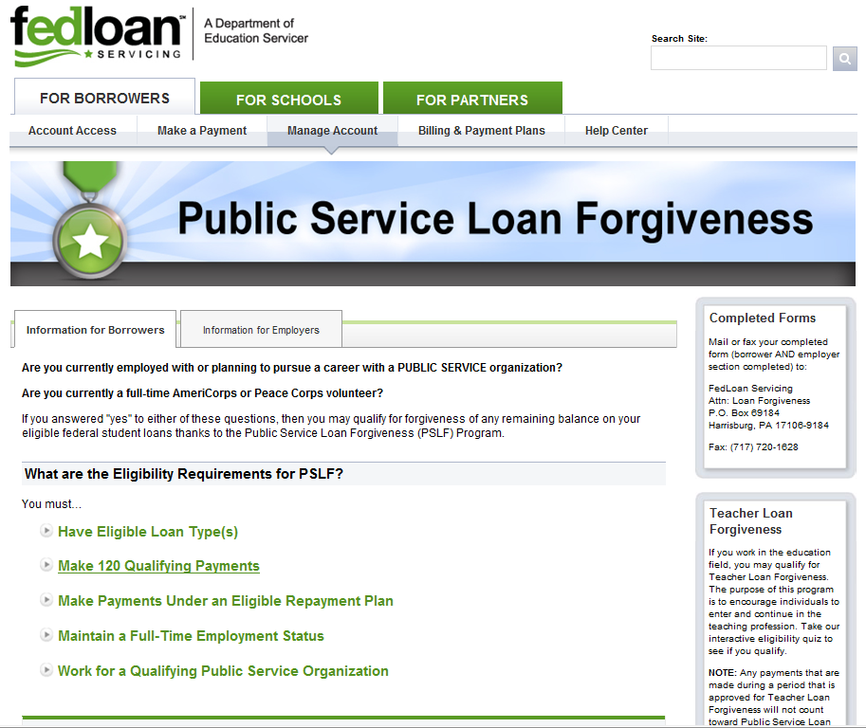
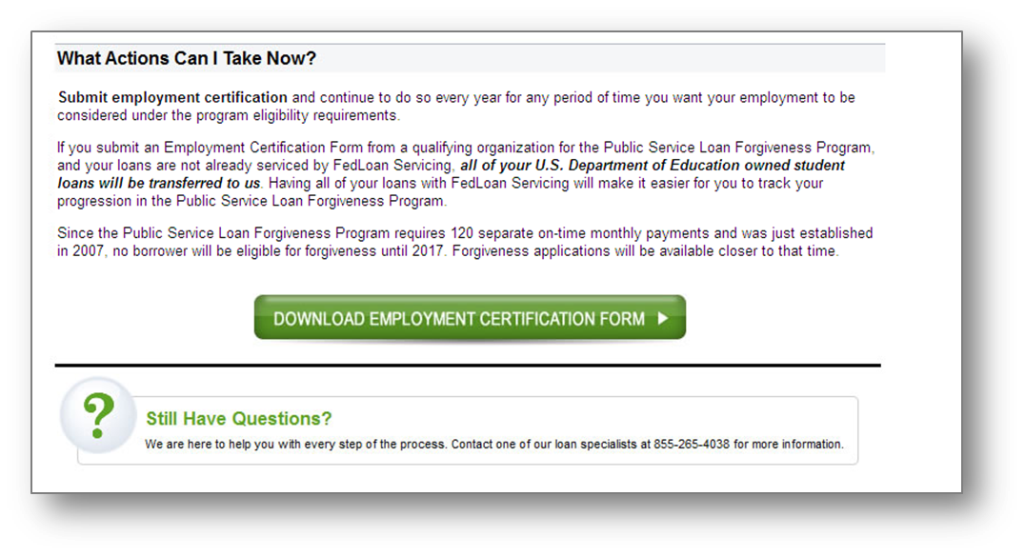
PSLF Awareness
MyFedLoan.org/PSLF

Slide 17
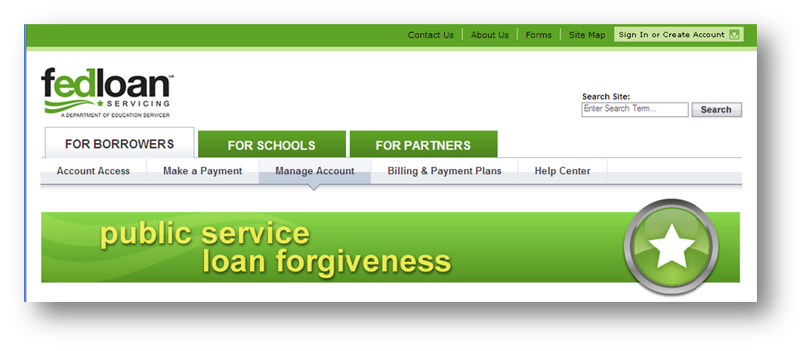
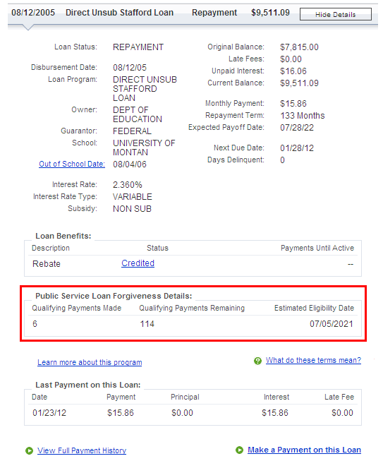
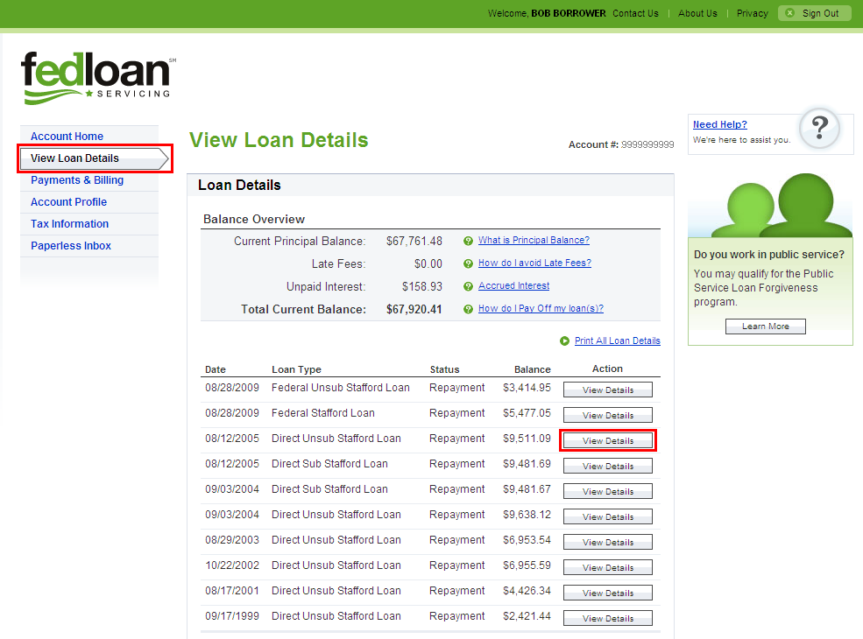
Payment Tracking for Eligible Borrowers

Slide 18
Identifying Qualifying Employers
Check with the employer regarding their classification (government, non-profit, etc.)
Depending on employer type, public websites are available:
Contact FedLoan Servicing if unsure
Government | http://www.usa.gov/Agencies.shtml
Tribal College/University | http://www.ed.gov/edblogs/whiaiane/tribes-tcus/tribal-colleges-and-universities/
Non-Profit 501(c)(3) | http://www.irs.gov/charities/index.html
Private Non-Profit | http://www.irs.gov/Charities-%26-Non-Profits/Charitable-Organizations/Private-Foundations

Slide 19
Frequently Asked Questions
Why will all of the federally-owned loans be transferred to FedLoan Servicing before the student reaches the required 120 payments?
  As the sole servicer for PSLF, FedLoan Servicing is responsible for tracking a borrower’s progress toward meeting the requirement of 120 separate, on-time monthly payments while working full-time for a qualifying public service employer.
Are all federally-owned loans eligible for PSLF?
  No, it is important to note that, while the federally-owned FFELP PUT loans will be moved to FedLoan Servicing for a borrower with qualifying employment, only Direct Loans, including Direct Consolidation Loans, are eligible for forgiveness. Payments made to FedLoan Servicing on non-eligible loan types will not be tracked.
Will the borrower’s commercially-held loan volume be transferred to FedLoan Servicing?
  No, they will remain with their commercial servicer.

Slide 20
Frequently Asked Questions
Are borrowers of PLUS Loans for parents eligible for PSLF?
  Parents with PLUS loans may consolidate their Federal PLUS Loans and/or Direct PLUS loans and pay under Income-Contingent Repayment (ICR). Parents must qualify based on their own public service, not the student for whom they borrowed.
Why should borrowers interested in PSLF use Income-Based Repayment (IBR), Income-Contingent Repayment (ICR) or Pay As You Earn?
  These repayment plans are the most likely to leave an outstanding balance to forgive after 120 payments.
Under IBR, ICR and Pay As You Earn the scheduled payment for a borrower could be $0. Does this payment count as towards PSLF?
  Yes, this is considered a qualifying payment under that repayment plan.

Slide 21
Frequently Asked Questions
Will the information provided from each of the federal servicers on this program be consistent?
  All federal servicers use the same form packet.
Are the 120 full, monthly payments required to be consecutive?
  No, they do not need to be consecutive.
How do overpayments impact a borrower’s qualifying payments?
  If a borrower pays more than the installment amount on any payment, it will only count towards one qualifying payment based on program requirements.
Are loan amounts forgiven for PSLF considered income for tax purposes?
  No, they are not considered income.

Slide 22
Partnering with Schools
Borrower Toolkits for outreach to current and past student borrowers
Reporting Available
  Customized email communications showing the number of borrowers for your institution who have submitted an Employment Certification Form
  Student detail information through the FedLoan Servicing School Portal
Training resources and personalized support
  Presentation available for download, Take 5 video overview
  Sector-based, personalized support

Slide 23
Counseling Eligible Borrowers
The first step is to determine what the student is doing after school.
If a career in public service is being pursued, PSLF eligibility should be explored.
If PSLF is being considered, the borrower should:
  Determine eligibility for income-driven repayment plans (IBR,ICR and Pay As You Earn)
  Consolidate any FFELP loans under Direct Consolidation
  Make payments on time

Slide 24

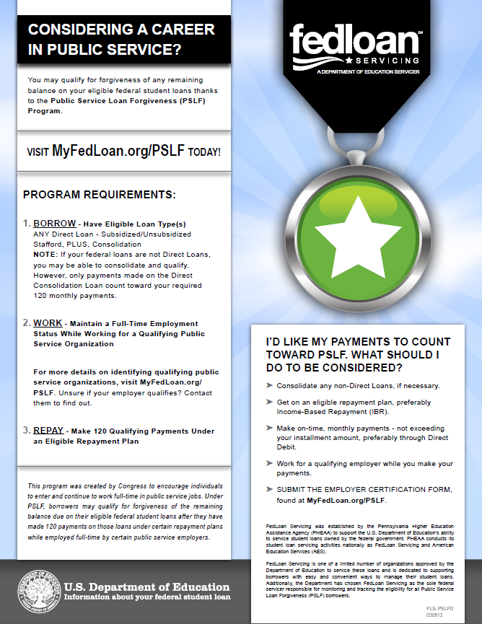
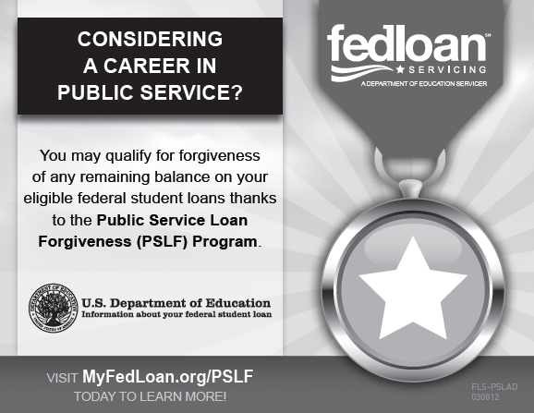
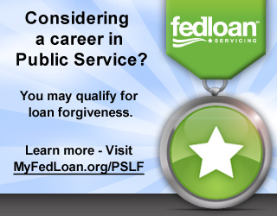
Current Student Toolkit
Considering a career in Public Service?
Contains:
Student Handout
Various Web and Print Ads
Sample Student Email
Sample Social Media Posts

Slide 25
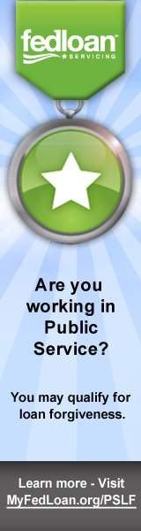
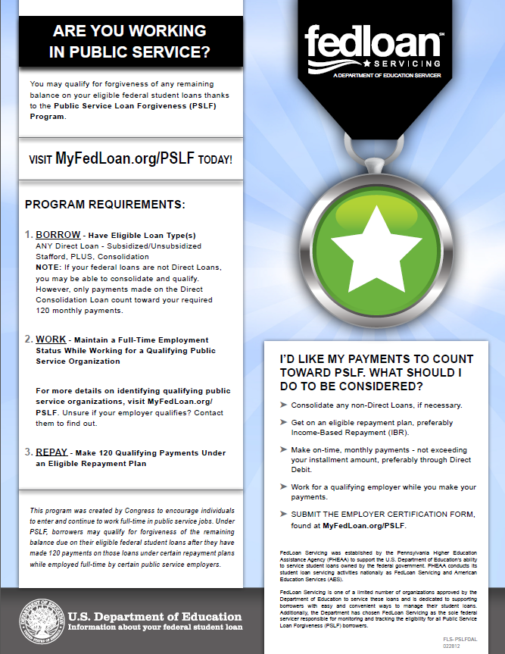
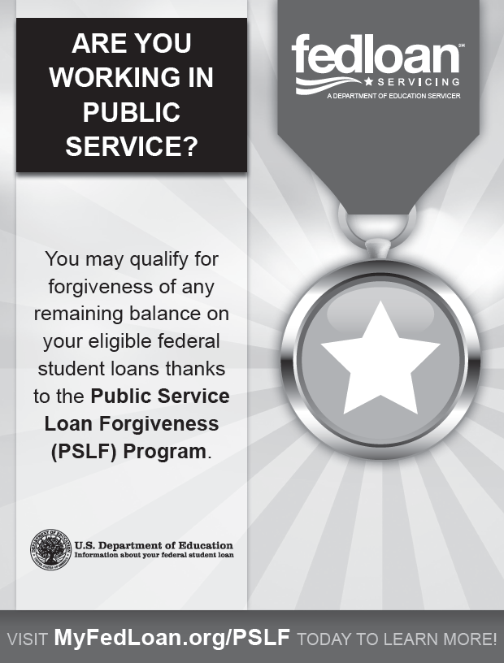

Alumni Toolkit
Contains:
Alumni Handout
Various Web and Print Ads
Sample Alumni Email
Sample Social Media Posts

Slide 26
School and Borrower Resources
PSLF Fact Sheet and Q&As: www.studentaid.ed.gov/publicservice
2011 FSA Conference Presentation on PSLF:
http://www.ifap.ed.gov/presentations/2011FSAConference.html
Borrower Information and Employment Certification Form from FedLoan Servicing: www.MyFedLoan.org/PSLF
PSLF Borrower Toolkits: http://www.myfedloan.org/schools/products-tools/public-service-loan-forgiveness-toolkit.shtml
IBR, ICR and Pay As You Earn Calculators: http://www.finaid.org/calculators/ibr.phtml
CFBP Public Service Toolkit: http://files.consumerfinance.gov/f/201308_cfpb_public-service-toolkit.pdf
CFBP Action Guide for Employees: http://files.consumerfinance.gov/f/201308_cfpb_pledge-action-guide-for-employees.pdf

Slide 27
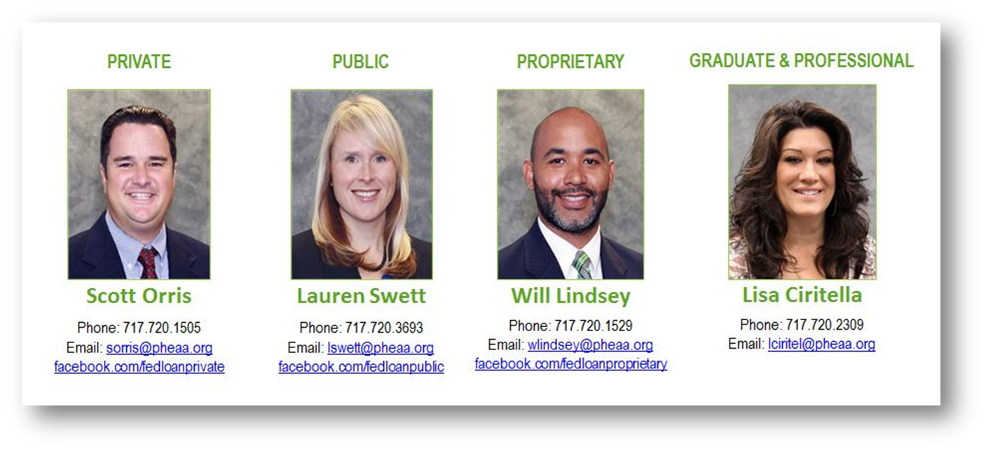
Questions?
Want to learn more? Contact your sector representative!

Slide 28
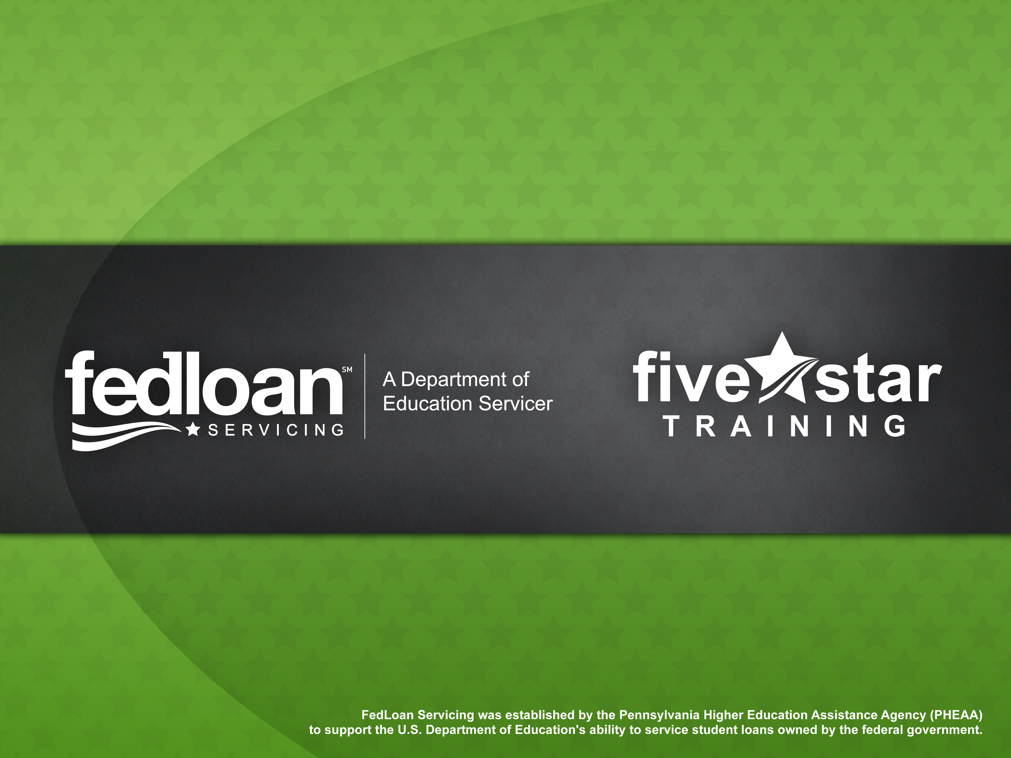
Notes:
This slide should be displayed at the end of the Power Point presentation.

